Slide 1
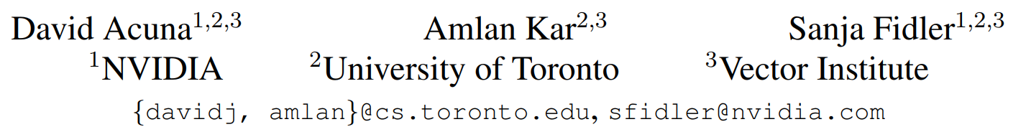
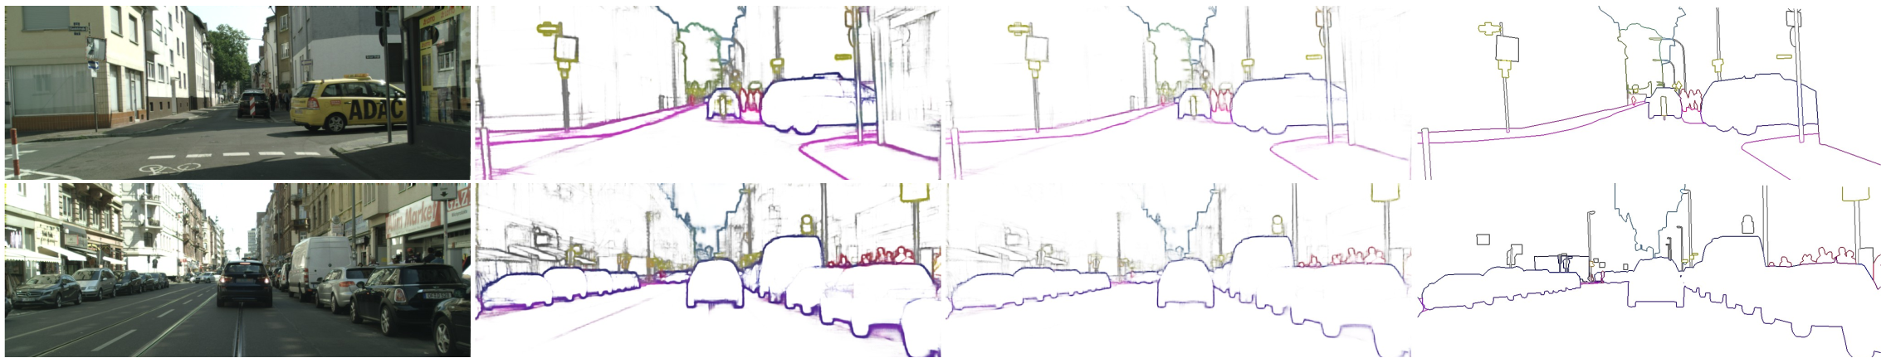
﻿﻿﻿ ﻿ ﻿Devil is in the Edges: Learning Semantic Boundaries from Noisy Annotations

Slide 2

Problem
Normal edge detector cause thick edge

Slide 3
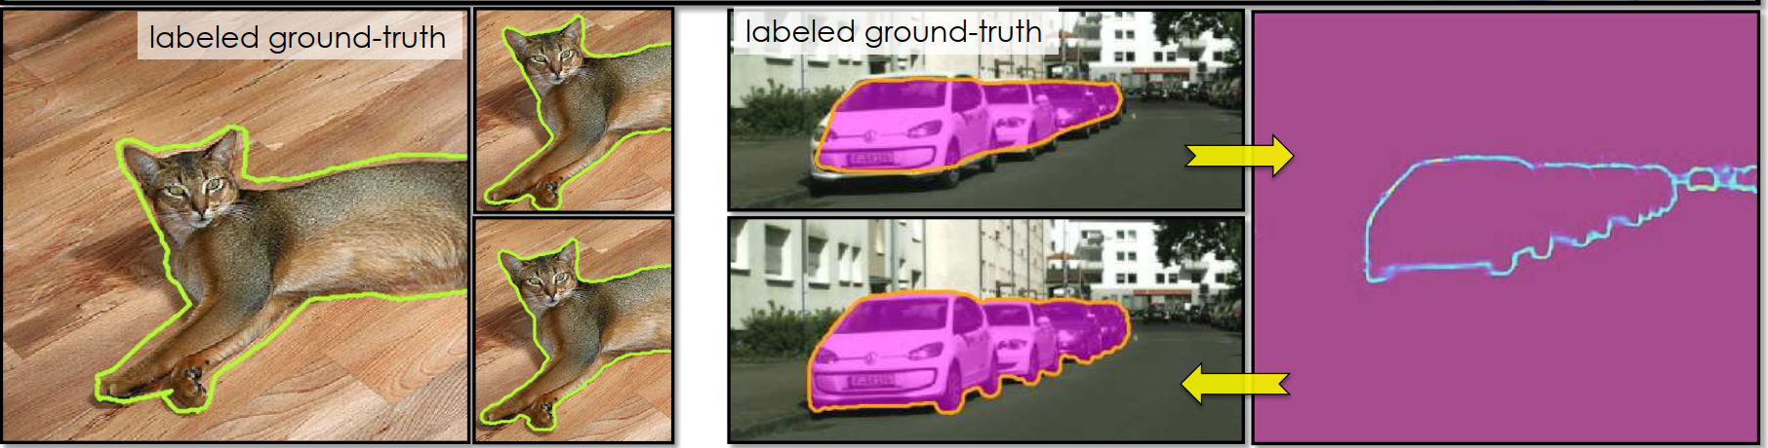
Problem
Normal edge detector cause thick edge
Reason: relevant datasets consist of a significant level of label noise
Should use post-process (like edge-NMS) to make edge thinner

Slide 4
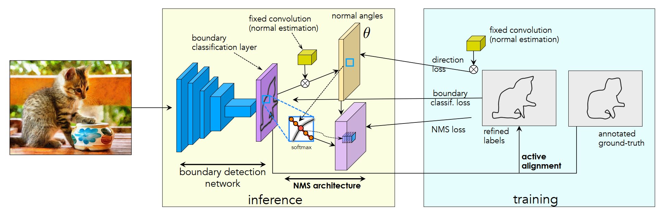
Contribution
1.Design Boundary Thinner Layer and NMS Loss to make layer thiner

Slide 5
Contribution
1.Design Boundary Thinner Layer and NMS Loss to make layer thiner
2.Active alignment to iteratively align the noisy boundary annotation

Slide 6
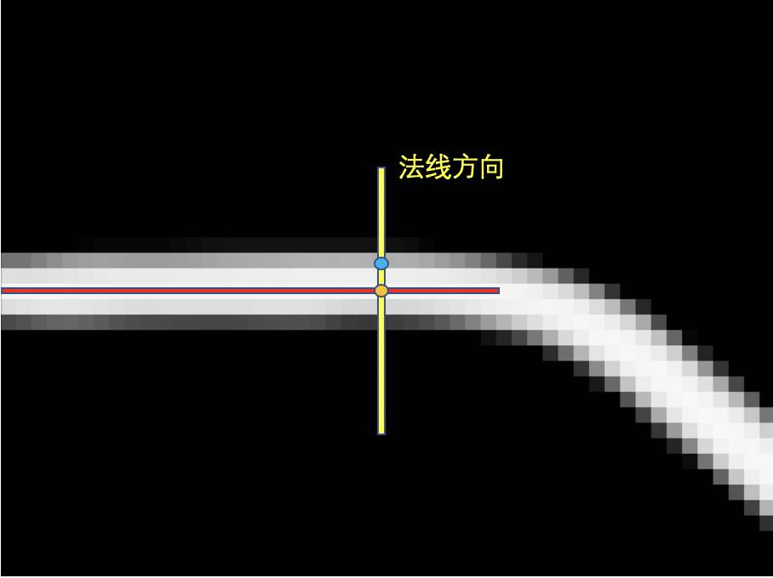
Method
Tradition edge NMS process

Slide 7
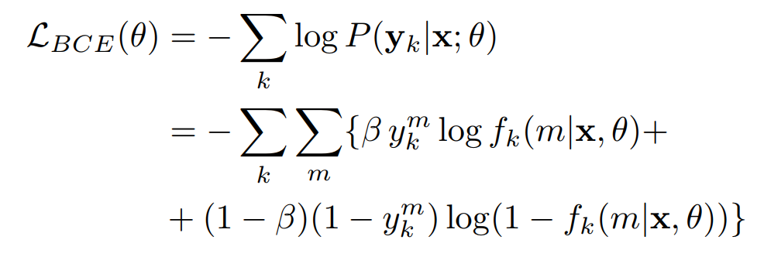
Method
Semantic Edge Learning (using BCE loss)
﻿Nearby pixels in each boundary map are considered to be independent

Slide 8
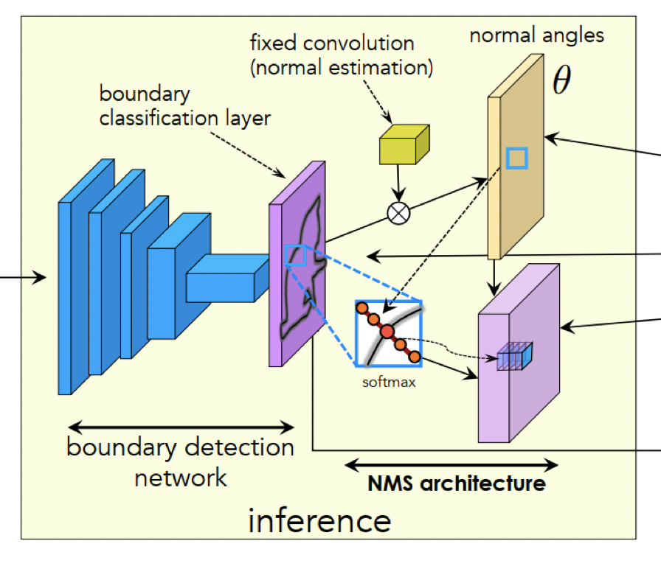
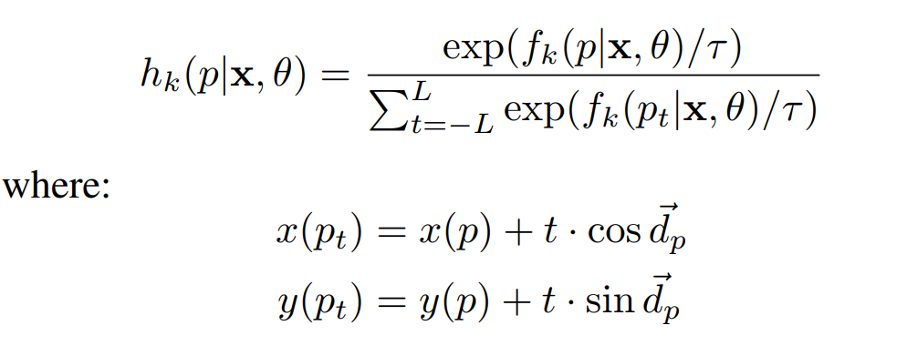
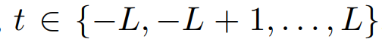
Method
Semantic Edge Learning (using BCE loss)
Here, and L denotes the maximum distance of a pixel pt from p along the normal.

Slide 9

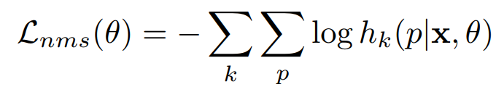
Method
Semantic Edge Learning (using BCE loss)
Here, and L denotes the maximum distance of a pixel pt from p along the normal.

Slide 10
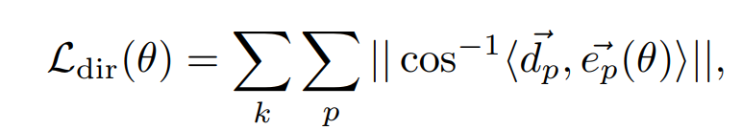
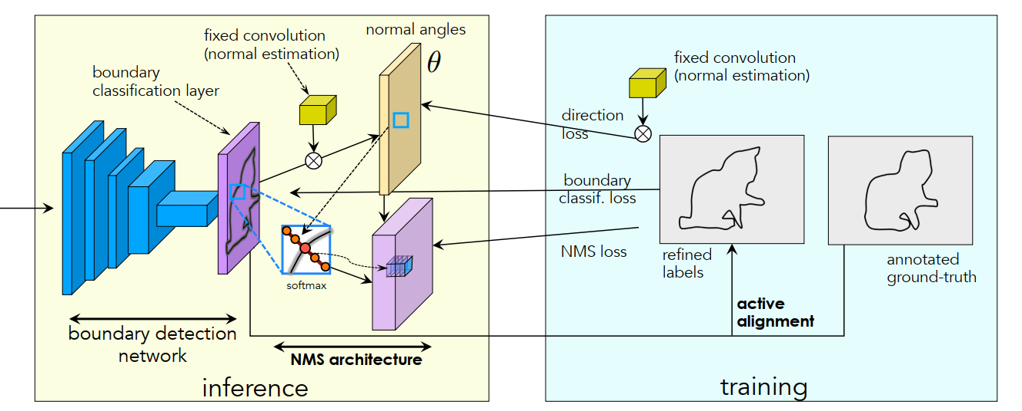
Method
Semantic Edge Learning (using BCE loss)

Slide 11
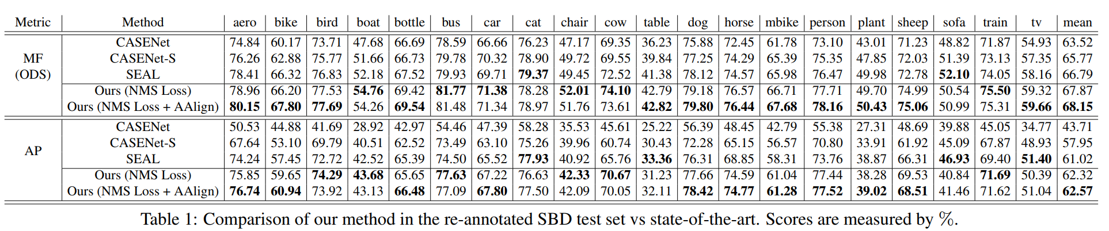
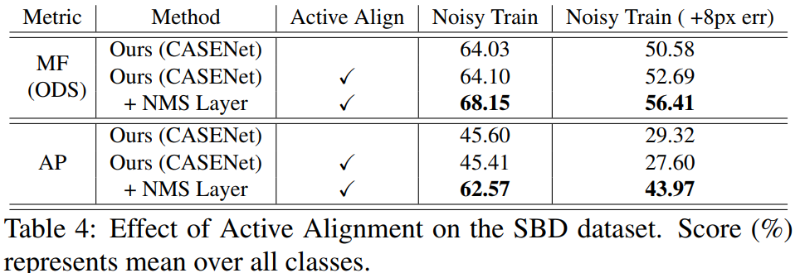
Result
Quantitive evaluation of semantic edge detection

Slide 12
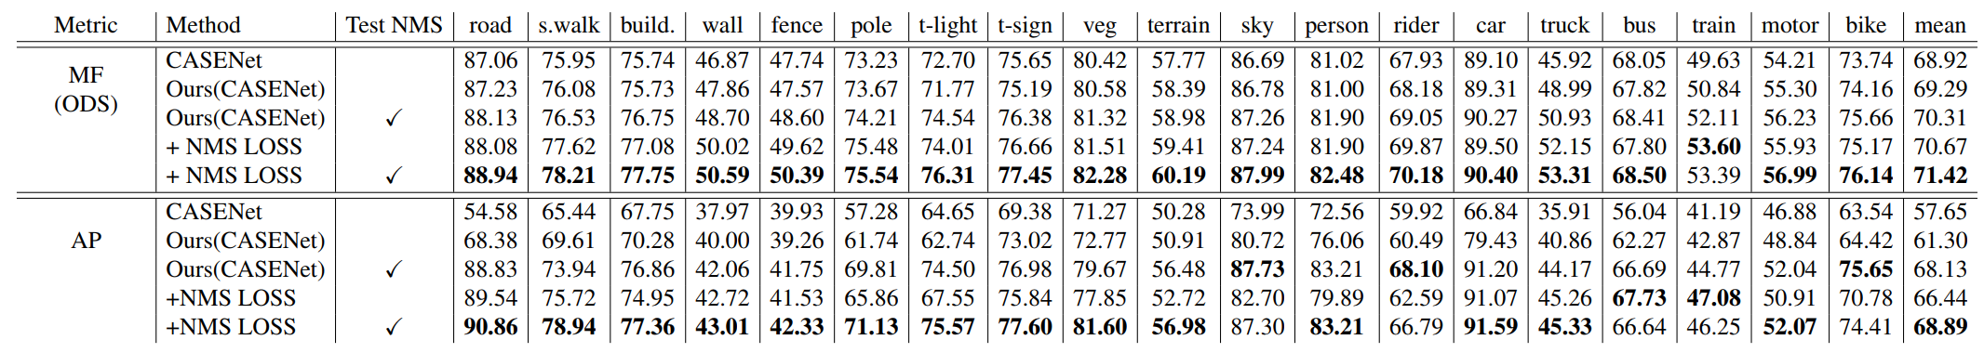
Result
Quantitive evaluation of semantic edge detection

Slide 13
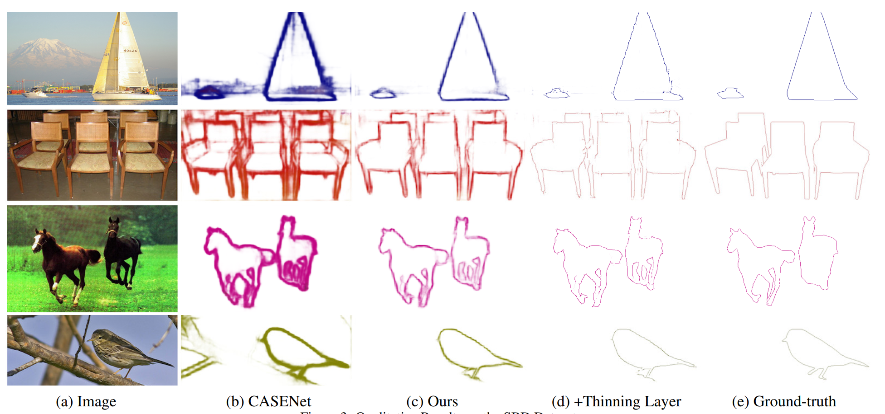
Result
Qualititive visualization of semantic edge detection

Slide 14
整体逻辑
介绍任务
问题：边缘很粗（由于标注不准确，edge detector很难准确定位到精确边缘，必须依靠edge nms手段来细化）
本文的主要贡献：1.设计了一个配套的thining layer和NMS loss来帮助细化边缘 2.使用了一种动态对齐（active align）的方法，逐渐回归到正确的边缘 （结合网络图）
传统的解决方案：edge nms方法
本文方法：将nms这个过程给可导化
本文方法：迭代地动态优化

